Slide 1



Business Analyst Capstone Project

Slide 2
Data Exploration
Statistical Analysis using Excel
Graphical Analysis using Excel
Insert the given data into the SQL server
Import the Data from the SQL Database into PowerBI
Interactive Dashboard by using visualization tools
Conclusion and Inferences
Endnotes

Slide 3
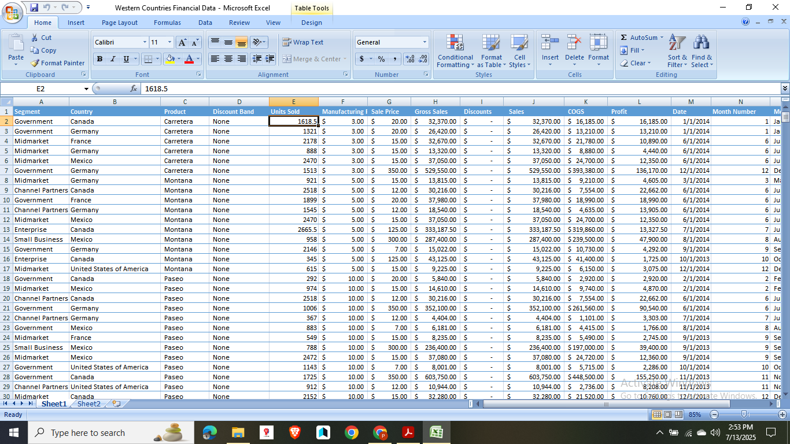
Financial Dataset

Slide 4
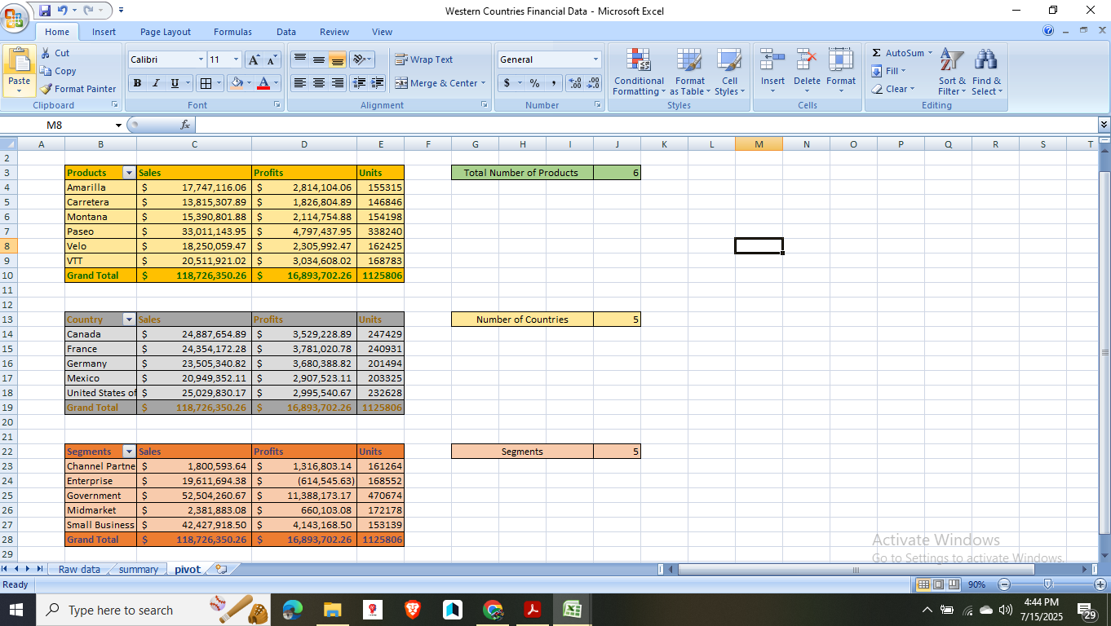
Data Exploration

Slide 5
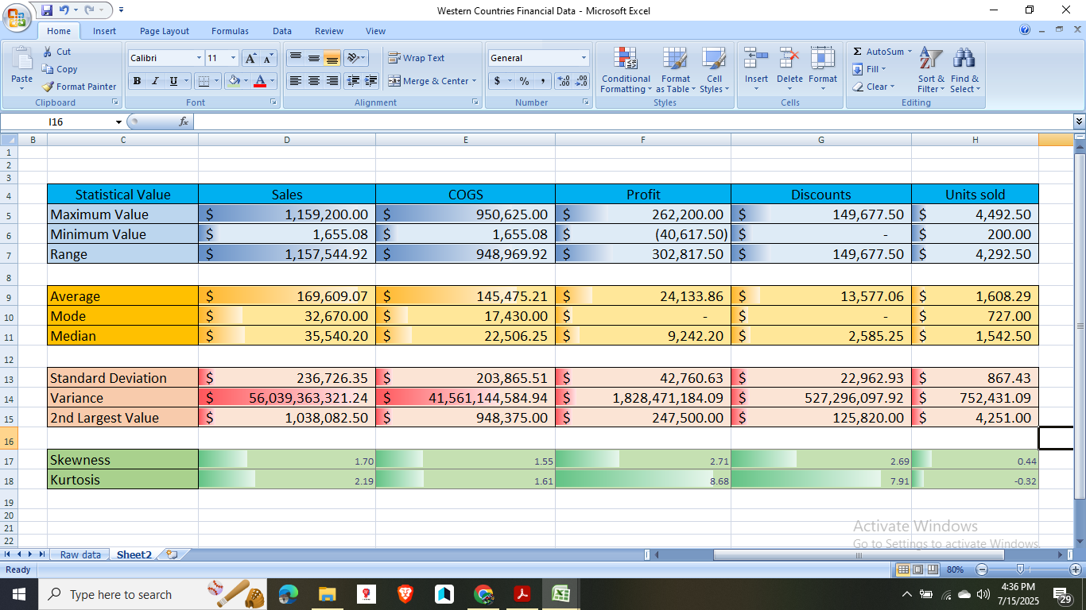
Statistical Analysis in Excel

Slide 6
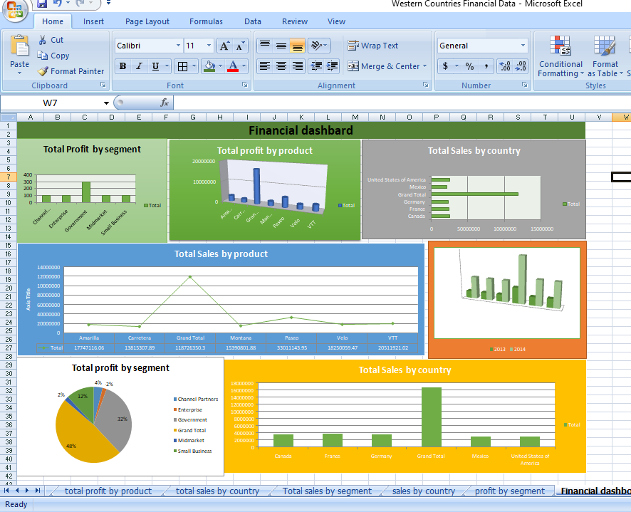
Geographical Analysis in Excel

Slide 7
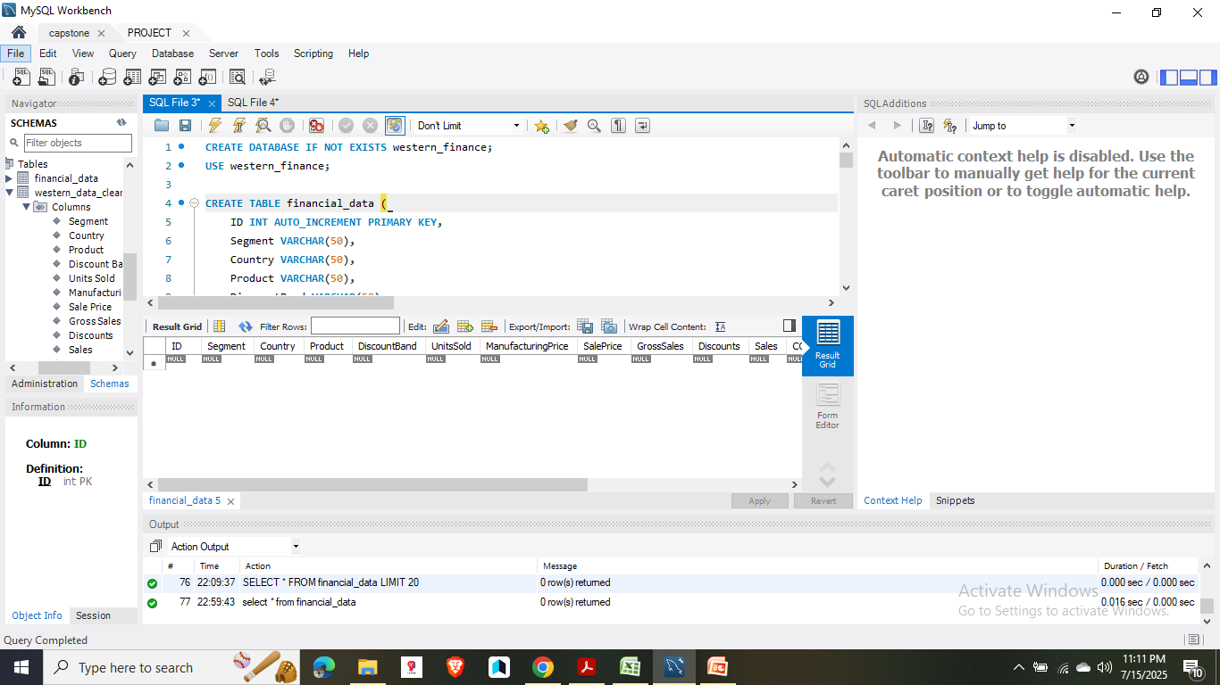
Inserting data in Excel data in SQL Server

Slide 8
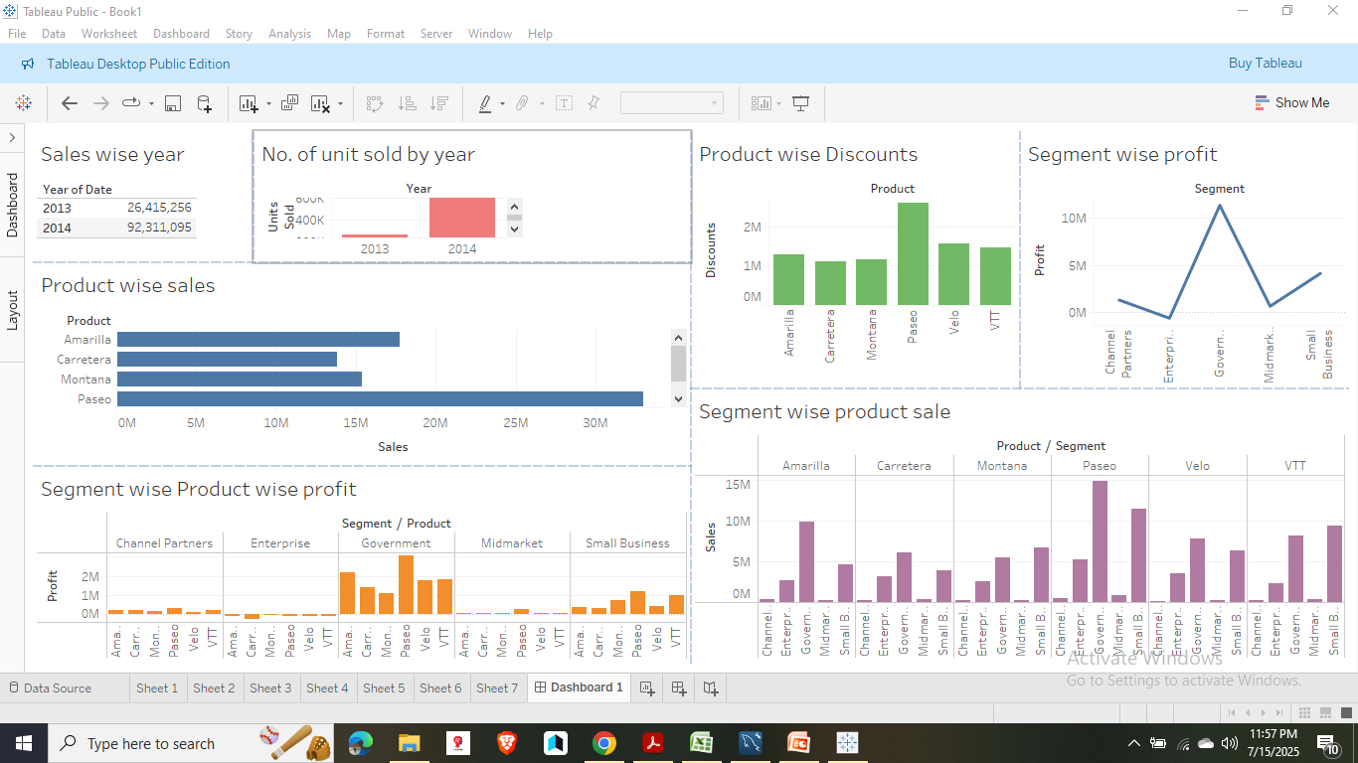
In this Slide I imported that data into Tableau and made the dashboard to solve questions given to solve the project

Slide 9
➔ Top 2 countries
As we can see revenue wise USA and Canada has highest sales
While France and Germany has highest profit share.
➔ Bottom 3 products-
Carretera, Montana, Velo
The given dashboard has
➔ Product wise Sales
➔Segment wise Profit
➔Yearly sales
➔Country wise Sales
➔ Profit and sales by Qtr.
➔ Yearly profit
➔ Product wise discount
➔ No. of units sold year over year
➔ Segment wise Product Sales
➔ Segment wise product wise profit

Slide 10


